Slide 1
DEEP LEARNING BASED APPROACH TO FIRE DETECTION SYSTEM
SUBHA CHAKRABORTY (12020002011014)
SUBROTO RAKSHIT (12020002016039)
PRATYUSH RANJAN (12020002004036)
PRABHAT KUMAR (12020002016037)
PAYEL CHATTERJEE (12020002004054)
AJAY KUMAR MANDAL(12020002016040)
Under the guidance of
Prof . Ayan Kumar Panja Sir
(Assistant Professor )
Institute of Engineering & Management
17-04-2024
LAB PROJECT
INSTITUTE OF ENGINEERING & MANAGEMENT

Slide 2
PRESENTATION OUTLINE
1
2
3
4
5
INTRODUCTION | MOTIVATION BEHIND PURSUING THE PROJECT | PROPOSED METHODOLOGY | RESULTS & ANALYSIS | CONCLUSION
LAB PROJECT
INSTITUTE OF ENGINEERING & MANAGEMENT

Slide 3
INTRODUCTION
In today's tech-driven era, AI and ML play pivotal roles in bolstering public safety. Our project introduces an advanced fire detection system leveraging the Inception V3 CNN model. With a 98.98% accuracy rate, it surpasses traditional methods, minimizing false alarms.
Application Domain: The deep learning based fire detection system can be applied in different places such as commercial buildings, industrial facilities, residential areas, transportation hubs, and critical infrastructure.
Aims and Objective:
Develop a reliable and efficient fire detection system.
Utilize CNN algorithm(Inception V3) for timely detection and response.
Minimize loss of life and property in fire-related incidents.
Demonstrate practical applicability of deep learning in safety and security.
LAB PROJECT
INSTITUTE OF ENGINEERING & MANAGEMENT

Slide 4
MOTIVATION
Prompt detection of fires is imperative for effective fire prevention and control, considering the grave consequences they entail. Early detection facilitates swift evacuation of residents, timely deployment of firefighting resources, and containment of the fire before it escalates. This proactive approach not only reduces the likelihood of fatalities and injuries but also minimizes property damage and mitigates the adverse environmental and economic impacts of fires. Therefore, the development of advanced fire detection systems is crucial for enhancing protection, safety, and resilience in both residential and commercial settings.
For example, in 2024, 39 people have died and 100 people have been injured fire incidents in Delhi so far. (16 people lost their life in January, 16 people lost their life in February and another 7 in March), highlighting the need of efficient fire detection system.
LAB PROJECT
INSTITUTE OF ENGINEERING & MANAGEMENT

Slide 5
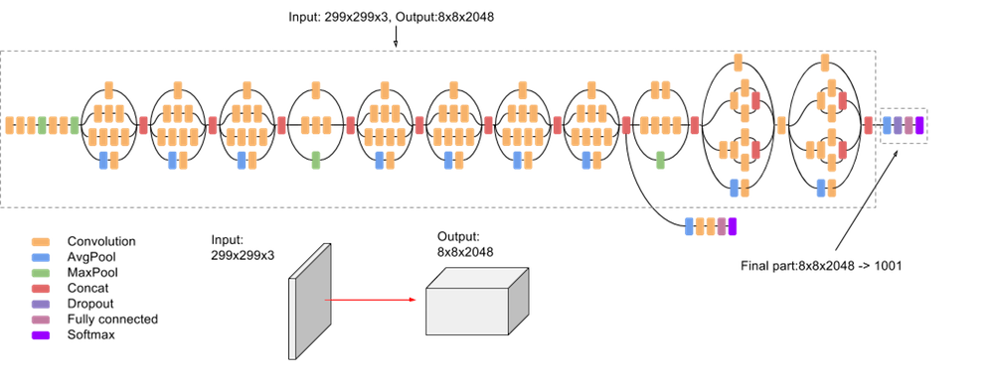
PROPOSED METHODOLOGY
In this project, we use a CNN(Inception V3)based approach to detect fire(ex: building fire, factory fire, etc). It will help to detect fire , and early steps can be taken against the fire.
What is Inception V3?
Inception V3 is a CNN architecture by Google for image classification. It uses inception modules to capture features at various scales and employs techniques like batch normalization for faster training. Widely used in computer vision, it excels in tasks like image classification and object detection.
LAB PROJECT
INSTITUTE OF ENGINEERING & MANAGEMENT

Slide 6
PROPOSED METHODOLOGY(WORKFLOW)
DATA COLLECTION FROM KAGGLE DATASET AS WELL AS FROM TEAM-MATES
PREPROCESSING: NORMALIZING AND AUGMENT THE DATA
MODEL TRAINING BY FINETUNING THE PARAMETERS
MODEL IS READY FOR DEPLOYMENT AND USE,SET UP THE DEPLOYMENT ENVIRONMENT
EVALUATE THE MODEL
STORE THE TRAINED MODEL TO THE LOCAL SYSTEM AND RETRIEVE IT
LAB PROJECT
INSTITUTE OF ENGINEERING & MANAGEMENT

Slide 7
MODEL TRAINING AND DEPLOYMENT
After preprocessing, our model is trained with defined hyperparameters, followed by tuning. Once trained, it's saved locally for future access, eliminating the need for retraining. Loading the model enables plotting of accuracy and loss curves. Predictions can be made on sample images, as well as on video frames at one frame per second, facilitating fast processing. Output is a 2x1 array, indicating fire (index 0) or no fire (index 1). For image uploads, the code prompts for an image, saving a temporary copy on the server. If fire is detected, it's boxed and confidence is provided; otherwise, no box appears with corresponding confidence for no fire. Open CV module is employed for this project to work.
PARAMETER | VALUES
Learning Rate | 1.40E-04
Batch Size | 32
Epochs | 5
Optimizer | Adam Optimizer
Loss Function | Binary Cross Entropy
Kernel Size | 3*3
Activation Function | Sigmoid
Regularization Method | Dropout
Regularization Rate | 0.5
Hyperparameter and values used for the models
LAB PROJECT
INSTITUTE OF ENGINEERING & MANAGEMENT

Slide 8
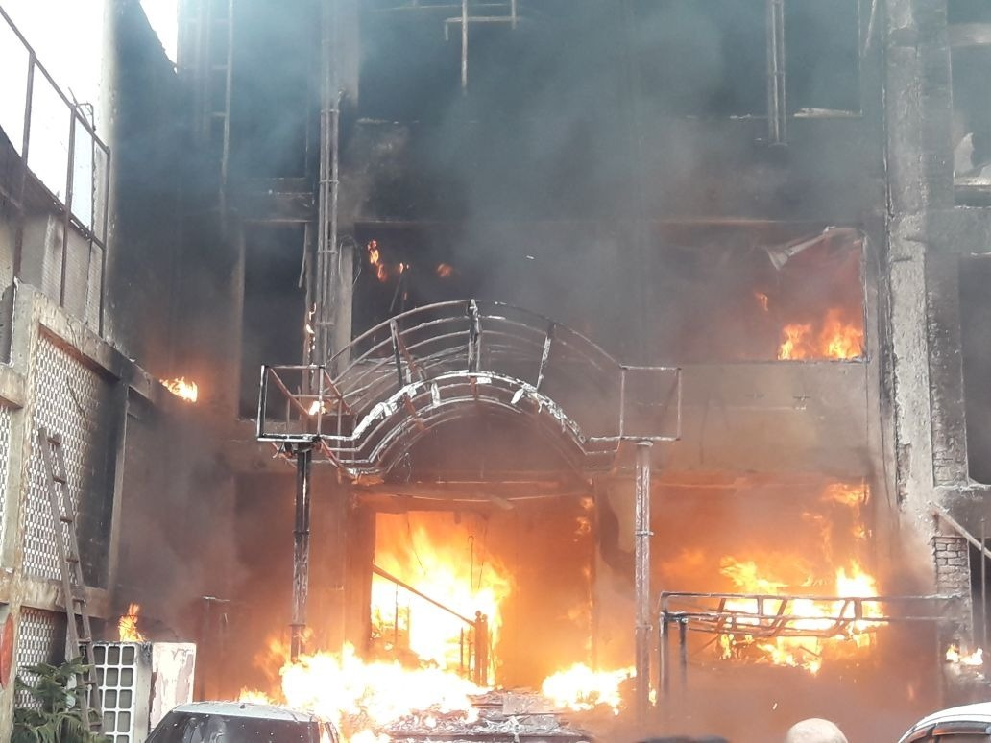
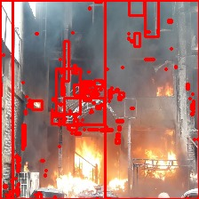
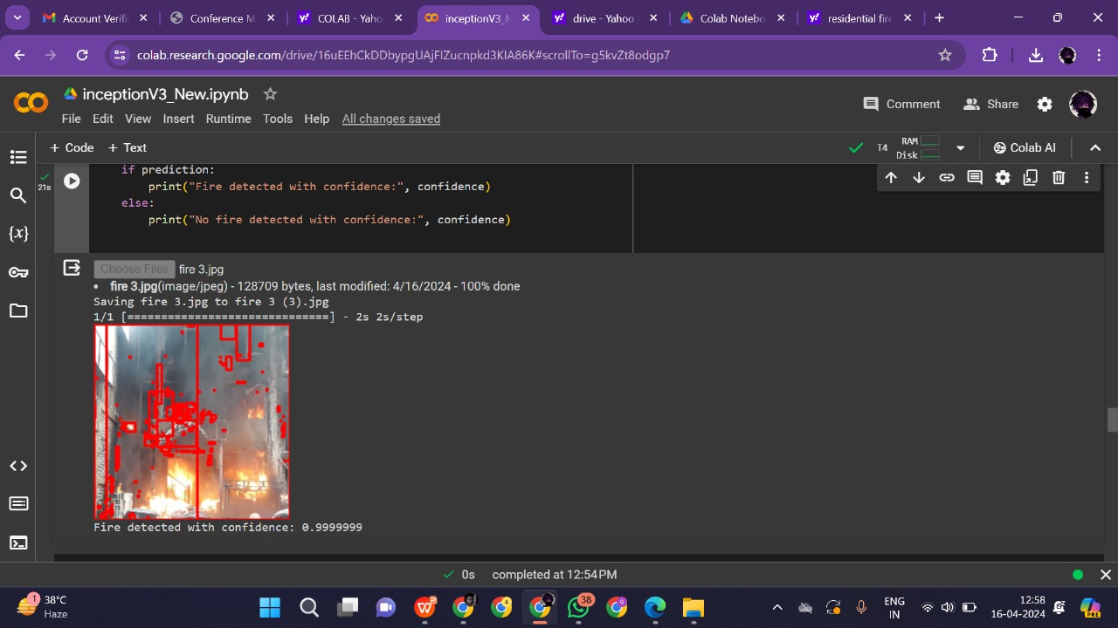
Fire Detected
Example data taken
Fire detected with a confidence of 99.99%
LAB PROJECT
INSTITUTE OF ENGINEERING & MANAGEMENT

Slide 9
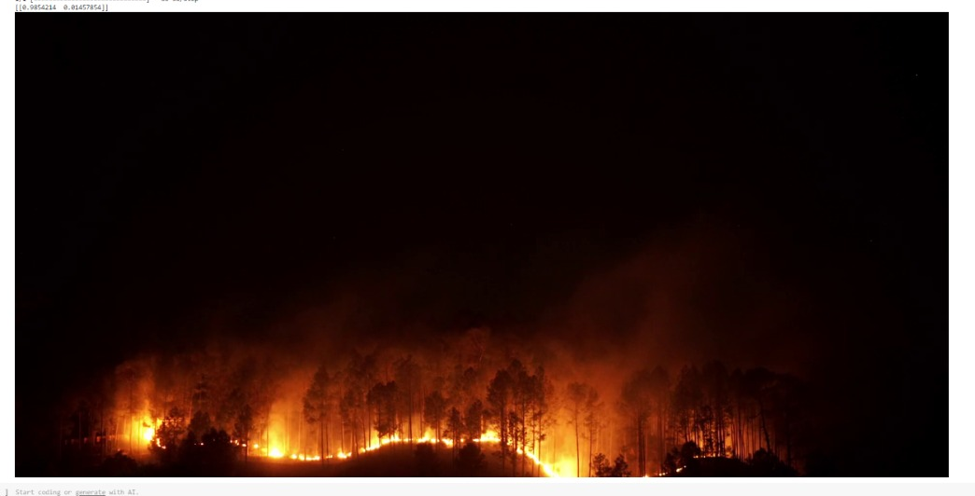

CONTINUED……
we can see that, index 0 confidence value is 98% and index 1 value is 1.4%. If the confidence is higher than 97% (approx.), it can be said that fire is there, else the image needs to be processed for a more accurate result.
Video Frames on which predictions are made
LAB PROJECT
INSTITUTE OF ENGINEERING & MANAGEMENT

Slide 10
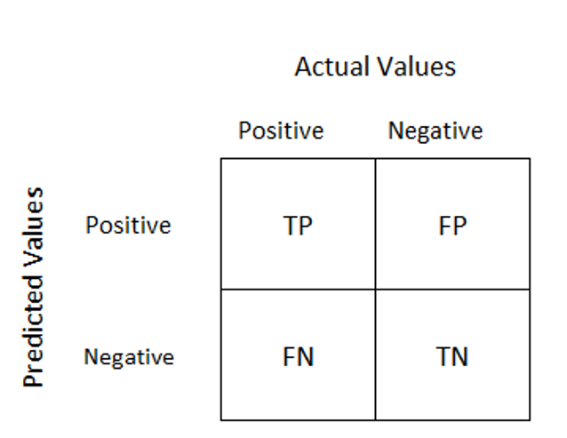



RESULT & ANALYSIS
EVALUATION METRICS USED
The Evaluation Metrics used for choosing the optimal model for our project involved measuring the accuracy of the model and its F1 score. Before we observe the metrics it is important to observe certain terms namely:
THE CONFUSION MATRIX
LAB PROJECT
INSTITUTE OF ENGINEERING & MANAGEMENT

Slide 11
RESULT & ANALYSIS(CONTINUED..)
SUMMARY OF THE RESULTS
MODEL | ACCURACY | F1 SCORE
Inception V3 | 98.98 | 99.52
Alex Net | 90 | 84.21
Basic Model | 86.5 | 26
ZFNet | 72.2 | 77.4
Based on these results, the Inception V3 model emerges as the optimal choice for fire detection purposes in our project. Its remarkable accuracy and F1 Score make it well-suited for reliable and efficient fire detection applications.
Graphical Representation of the Accuracy and F1 scores of the models
LAB PROJECT
INSTITUTE OF ENGINEERING & MANAGEMENT

Slide 12
CONCLUSION
In conclusion, the selection of Inception V3 for fire detection represents a strategic choice informed by meticulous experimentation and performance evaluation, which is evident from its impressive accuracy rate of 98.98% and an F1 Score of 99.52%. Its remarkable attributes and exceptional performance metrics underscore its suitability for our application, promising enhanced fire detection capabilities and improved safety measures.
LAB PROJECT
INSTITUTE OF ENGINEERING & MANAGEMENT

Slide 13
RESEARCH PAPER PUBLISHED
Paper Communicated: Our paper “Deep Learning Based Approach to Fire Detection System” has been communicated to the esteemed International conference on Artificial Intelligence and Sustainable Computing.
Related work to be published: Mukherjee, Amartya, et al. "A 6G-enabled Edge-assisted Internet of Drone Things Ecosystem for Fire Detection."
Proceedings of the 4th International Conference on Frontiers in Computing and System, October 2023
LAB PROJECT
INSTITUTE OF ENGINEERING & MANAGEMENT

Slide 14
REFERENCES
Bin Zhang; Linkun Sun; Yingjie Song; Weiping Shao; Yan Guo; Fang Yuan; DeepFireNet: A real-time video fire detection method based on multi-feature fusion , 09 November 2020[MBE]
Junxun Huang; Xuemei Ma; Yulong Wang; Xiao Li ; Real-time Video Fire Detection via Convolutional Neural Networks ,10 April 2023[IEEE]
Valquíria Hüttner; Cristiano Rafael Steffens; Silvia Silva da Costa Botelho; First response fire combat: Deep learning based visible fire detection, 18 December 2017 [IEEE]
Yaroju Raj Kumar; Vakati Surya Balaji; Vegesna Maneesh Varma; B. Ushasri; FIRE ACCIDENT DETECTION USING DEEP LEARNING, April-2022[IRJMETS]
https://github.com/DeepQuestAI/Fire-Smoke-Dataset/releases/download/v1/FIRE-SMOKE-DATASET.zip
LAB PROJECT
INSTITUTE OF ENGINEERING & MANAGEMENT

